Slide 1
C♯ Dependency Injection Unit Testing EF
Rasmus Lystrøm
External Associate Professor
ITU
rnie@itu.dk

Slide 2
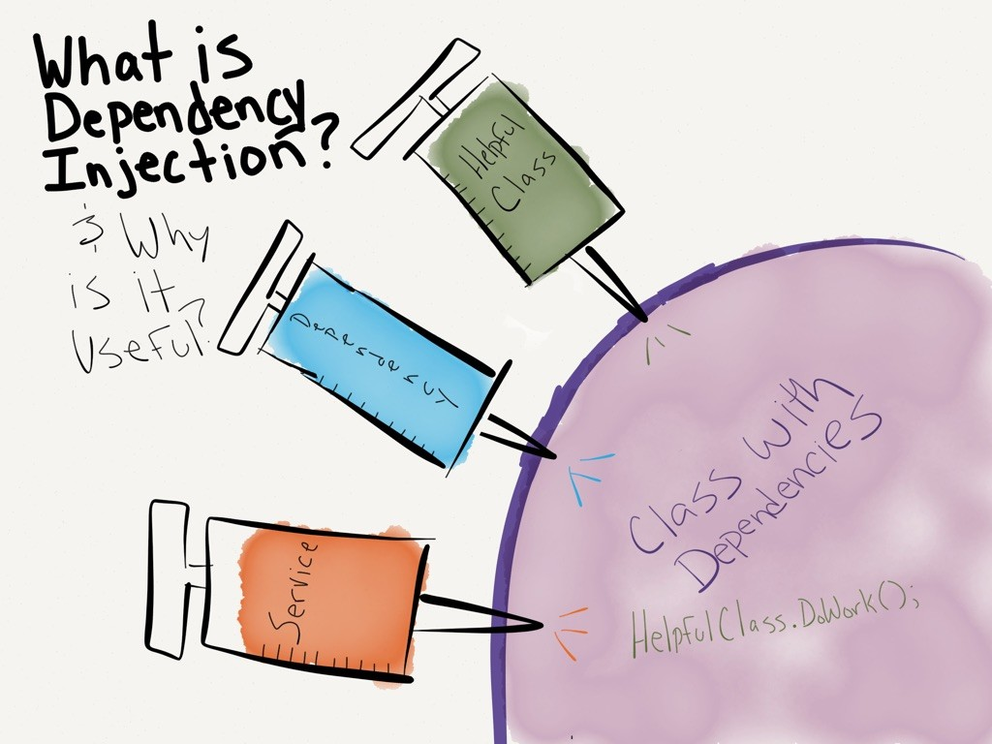
http://dwiardiirawan.com/index.php/2016/05/18/what-is-dependency-injection-and-what-are-the-advantage/

Slide 3
Dependency Injection (DI)
Software design pattern which implements Inversion of Control (IoC)
Constructor Injection
Property (setter) Injection
Interface Injection

Slide 4
Structered readable code Testable code Dependency Inversion Principle Separation of Concerns Rock SOLID!!! AWESOME!!
Pun intended

Slide 5
Programming to interface, not implementation…
public interface IFooService : IDisposable
{
bool Update(Foo foo);
}

Slide 6
Constructor Injection
public class Worker : IDisposable
{
private readonly IFooService _service;
public Worker(IFooService service)
{
_service = service;
}
public bool DoWork(FooDto fooDto)
{
// Implementation
}
public void Dispose()
{
_service.Dispose();
}
}
Private readonly field
Initialize from constructor
Remember to call Dispose…

Slide 7
Property Injection
Public setter
public class Worker : IDisposable
{
public IFooService Service { private get; set; }
public void DoWork(FooDto foo)
{
// Implementation
}
public void Dispose()
{
Service?.Dispose();
}
}
Dispose with the King…

Slide 8
Interface Injection
public interface IServiceSetter<T>
{
void SetService(T service);
}

Slide 9
Interface Injection II
Interface
public class Worker : IServiceSetter<IFooService>, IDisposable
{
private IFooService _service;
public void SetService(IFooService service)
{
_service = service;
}
public void DoWork(FooDto fooDto)
{
// Implementation
}
public void Dispose()
{
_service?.Dispose();
}
}
Implement interface

Slide 10
Interface Injection III
public interface IServiceSetter<T>
{
T Service { set; }
}

Slide 11
Interface Injection IV
Interface
public class Worker : IServiceSetter<IFooService>, IDisposable
{
public IFooService Service { private get; set; }
public bool DoWork(FooDto fooDto)
{
// Implementation
}
public void Dispose()
{
Service?.Dispose();
}
}
Implement interface

Slide 12
Best practices
Use constructor injection
Use Adapter to enable interface if needed
Implement cascading IDisposable if a dependency does
Use an IoC container

Slide 13
Unit Testing

Slide 14
Best Practices
Never test against a live database, file, or web service
Single Responsibility Principle
Only test the
”System Under Test”
Use either mocks or stubs

Slide 15
Stub testing
Test stub
public class FooServiceFalseStub : IFooService
{
public bool Update(Foo foo)
{
return false;
}
public void Dispose()
{
}
}

Slide 16
Stub testing II
public class WorkerTests
{
[Fact]
public void DoWork_when_IFooService_Update_false_returns_false()
{
IFooService service = new FooServiceFalseStub();
using (var worker = new Worker(service))
{
var result = worker.DoWork(new FooDto());
Assert.False(result);
}
}
}

Slide 17
Mock testing
Mock using Moq
public class WorkerTests
{
[Fact]
public void DoWork_when_IFooService_Update_false_returns_false()
{
var mock = new Mock<IFooService>();
IFooService service = mock.Object;
using (var worker = new Worker(service))
{
var result = worker.DoWork(new FooDto());
Assert.False(result);
}
}
}

Slide 18
Mock testing II
Configure the mock
public class WorkerTests
{
[Fact]
public void DoWork_when_IFooService_Update_true_returns_true()
{
var mock = new Mock<IFooService>();
mock.Setup(m => m.Update(It.IsAny<Foo>())).Returns(true);
using (var worker = new Worker(mock.Object))
{
var result = worker.DoWork(new FooDto());
Assert.True(result);
}
}
}

Slide 19
Demo

Slide 20
Testing Entity Framework

Slide 21
In Memory Database
// In Memory Database:emory Database:
var builder = new DbContextOptionsBuilder<FuturamaContext>()
.UseInMemoryDatabase(databaseName: nameof(<name>));
// SQLite:
var connection = new SqliteConnection("DataSource=:memory:");
connection.Open();
var builder = new DbContextOptionsBuilder<FuturamaContext>()
.UseSqlite(connection);
var context = new FuturamaContext(builder.Options);
context.Database.EnsureCreated();

Slide 22
Best practices
Implement IDisposable
Wrap in logical units/service classes/repositories
Don’t test built in code…
Program to interface

Slide 23
Demo

